Slide 1
Moveworks MIM Agent
11/10/2025

Slide 2
Agenda
MIM Moveworks Plugin – REST API calls to SN Table API
Now Assist Virtual Agent Bot – Add Comment to Incident
Integration Moveworks and NAVA API – Architectural challenges and possible solutions.

Slide 3
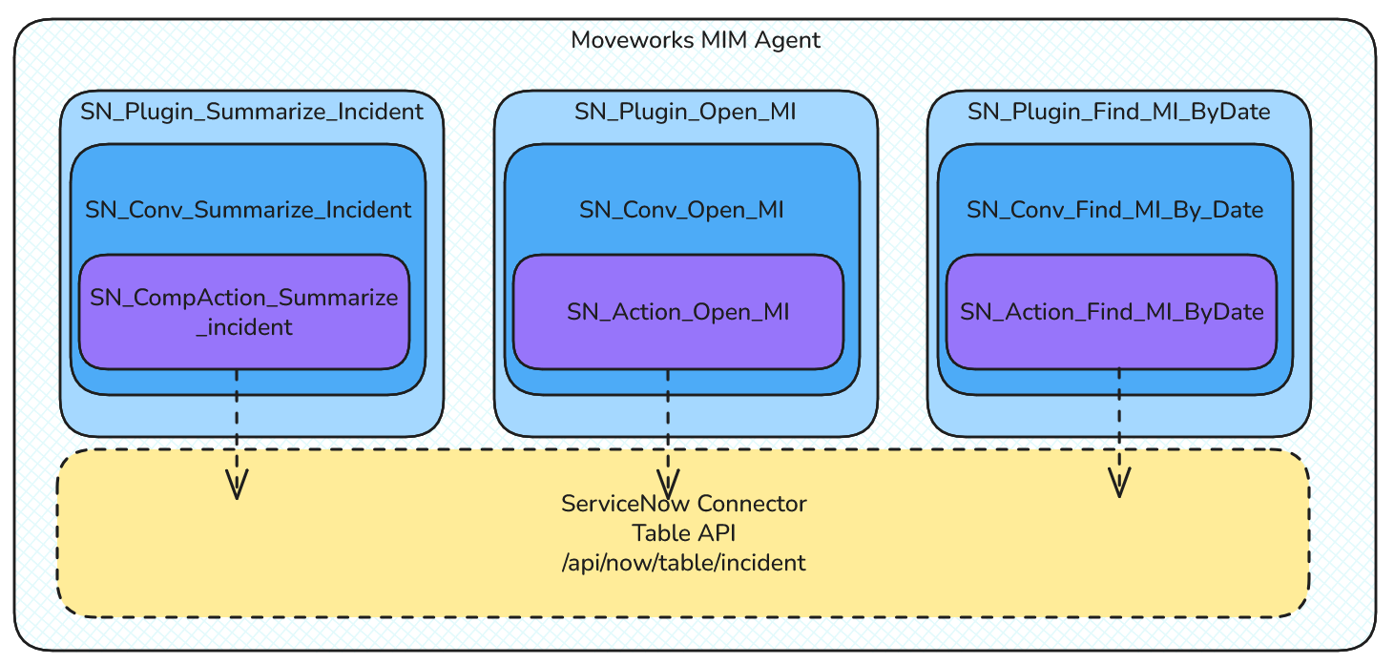
MIM Moveworks Plugin

Slide 4
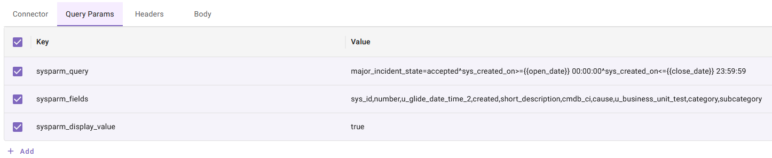
Find By Date Plugin
Finds MI by date range
What didn’t work:
major_incident_state=accepted^sys_created=ONjavascript:gs.dateGenerate('{{open_date}}','00:00:00')

Slide 5
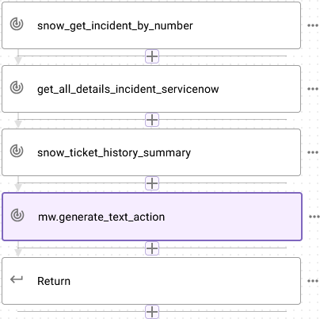
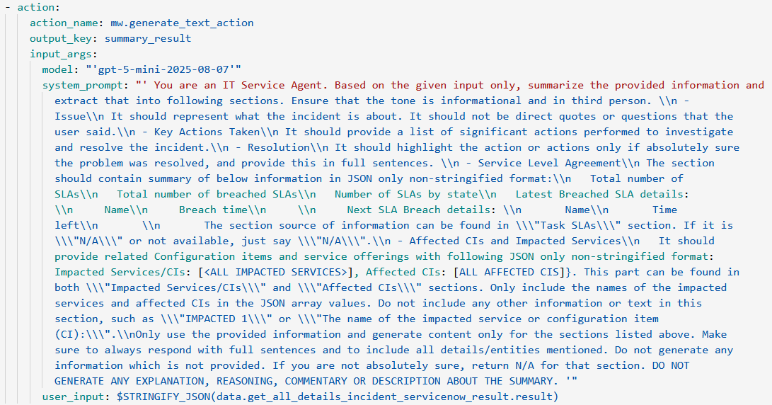
Summarize Incident Plugin
Compound action utilizes moveworks inbuilt LLM action to summarize INC details.
Moveworks In-Built LLM Action.
Can be used for summary, classification, sentiment analysis, etc.

Slide 6
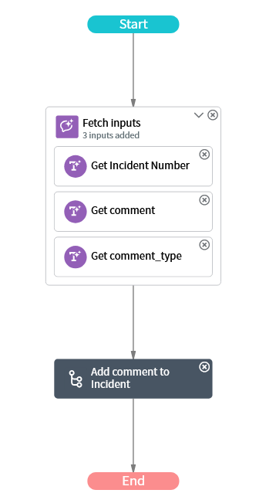
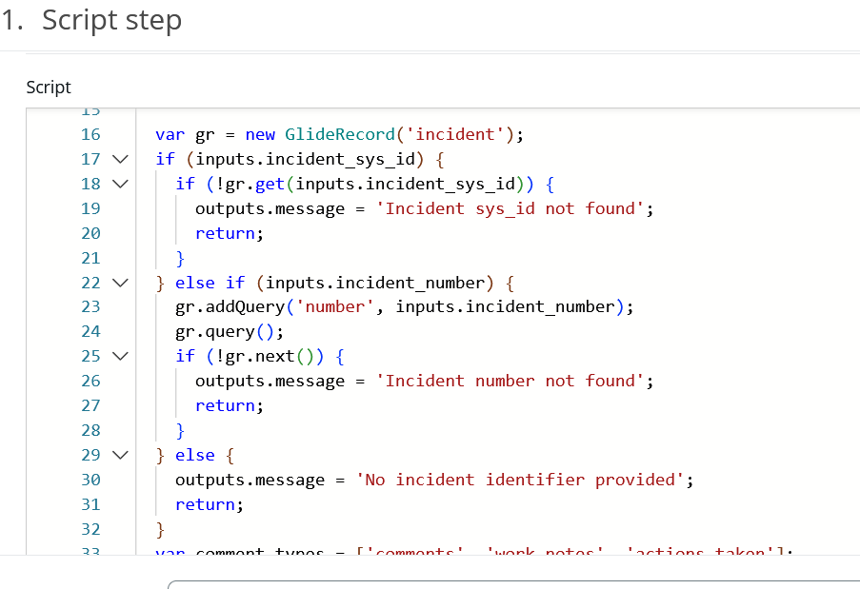
Add Comment to Incident VA Bot
Using Now Assist Capabilites to take input from User
Using a Flow Action to Add comment to incident

Slide 7
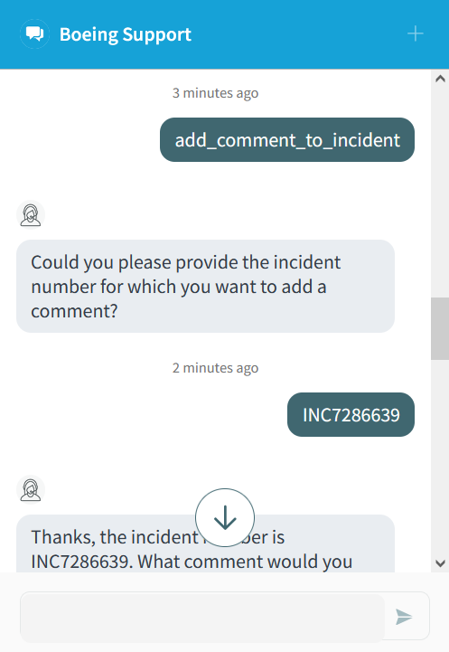
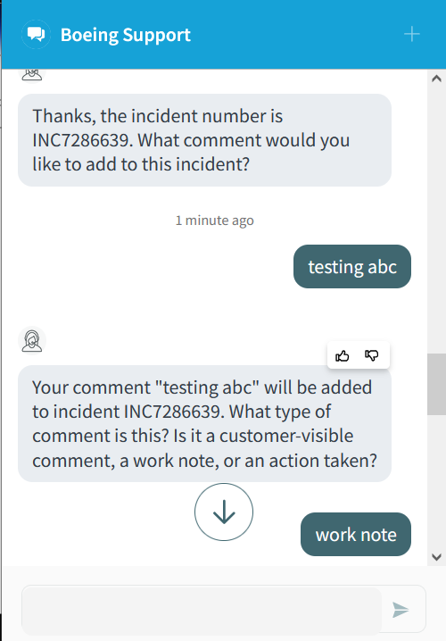
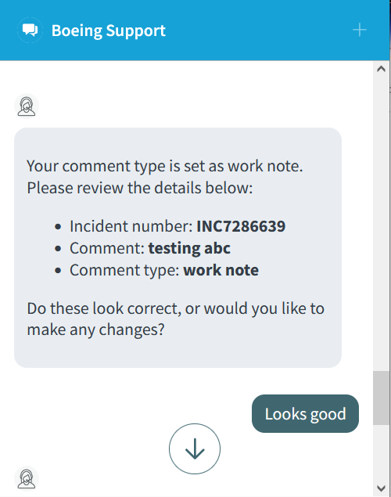
Example
Add Comment to Incident

Slide 8
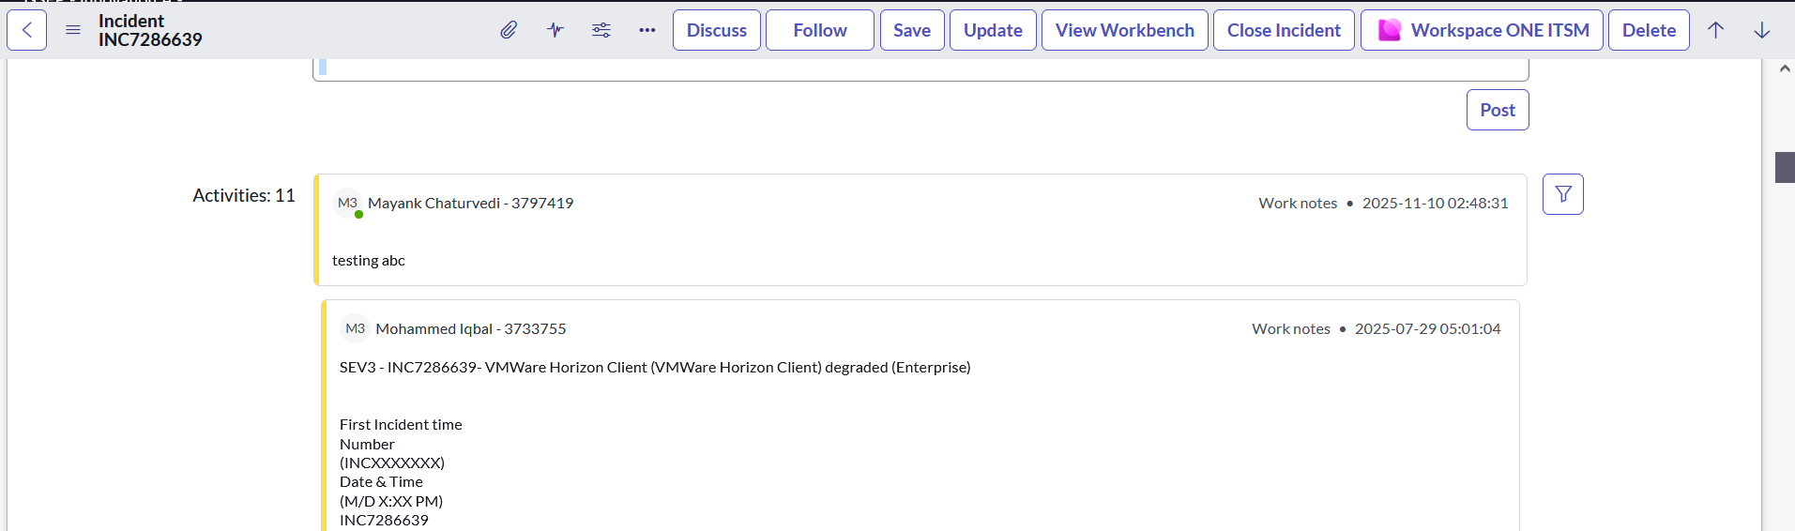
Example Result

Slide 9
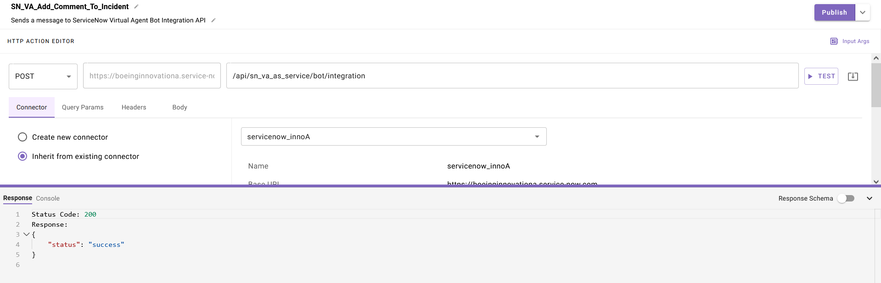
Integration Moveworks and SN VA API
Moveworks Chat Client invokes the ServiceNow Virtual Agent API
Why merely using Moveworks Connectors doesn’t work:
Virtual Agent Bot Interconnect API is asynchronous:
When we send a HTTP POST request, the API responds with the success/failure status. Moveworks Action completes here upon receiving this result.
But the actual VA response is processed later and sent to separate configured outbound REST endpoint.

Slide 10
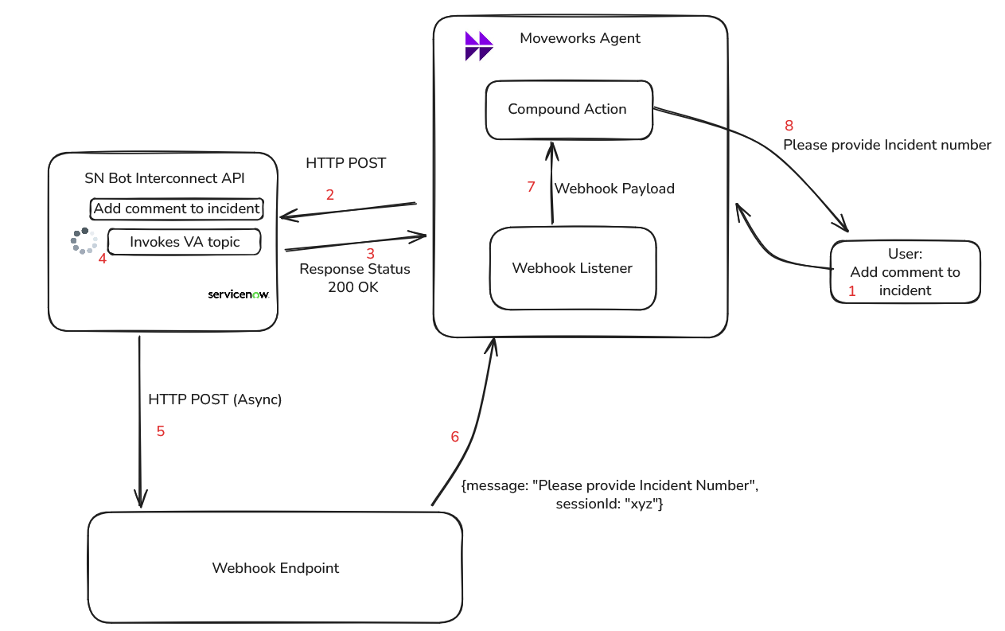
Moveworks Listeners (Webhooks)

Slide 11
ServiceNow
Ask Boeing (Moveworks)
Other Systems
SN Data
KB
INC, RITM,
Cat Item
User
AI Search
Moveworks indexed Data
Catalog Items
Data
Now Assist
ITSM Now Assist Skills
Moveworks Plugin’s
LLM
Virtual Agent
CMDB Now Assist Skills
LLM
Ask Boeing
Custom Agents
SN Live Agent
SN Virtual Agent API
Agent Integration
BCAI
Chat
Fulfiller Channels
End User Channels
LLM
Workspace
Classic UI
Now Assist
GSEP Portal
My Boeing
Teams
In Production
In Development
POC Evaluation

